Slide 1

Agentic RAG Chatbot
for Multi-Format Document QA using Model Context Protocol (MCP)
Presented by: Bhanu Prakash Guddeti

Slide 2

Problem Statement
The Challenge:
Build an agent-based Retrieval-Augmented Generation (RAG) chatbot that can answer user questions using uploaded documents of various formats. The architecture must follow an agentic structure and incorporate Model Context Protocol (MCP) as the mechanism for communication between agents.
Why It Matters:
Organizations need intelligent systems that can process diverse document formats and provide accurate answers based on their content. An agentic approach with structured communication protocols ensures scalability, maintainability, and improved performance.
Agentic RAG Chatbot
2

Slide 3




Core Functional Requirements
Document Support
Agentic Architecture
Model Context Protocol
PDF format support
IngestionAgent: Parses & preprocesses documents
PPTX format support
Structured communication between agents
RetrievalAgent: Handles embedding + semantic retrieval
CSV format support
JSON-based message format
DOCX format support
Includes sender, receiver, type, trace_id
TXT/Markdown format support
LLMResponseAgent: Forms final LLM query using retrieved context
Payload with relevant data
Agentic RAG Chatbot
3

Slide 4

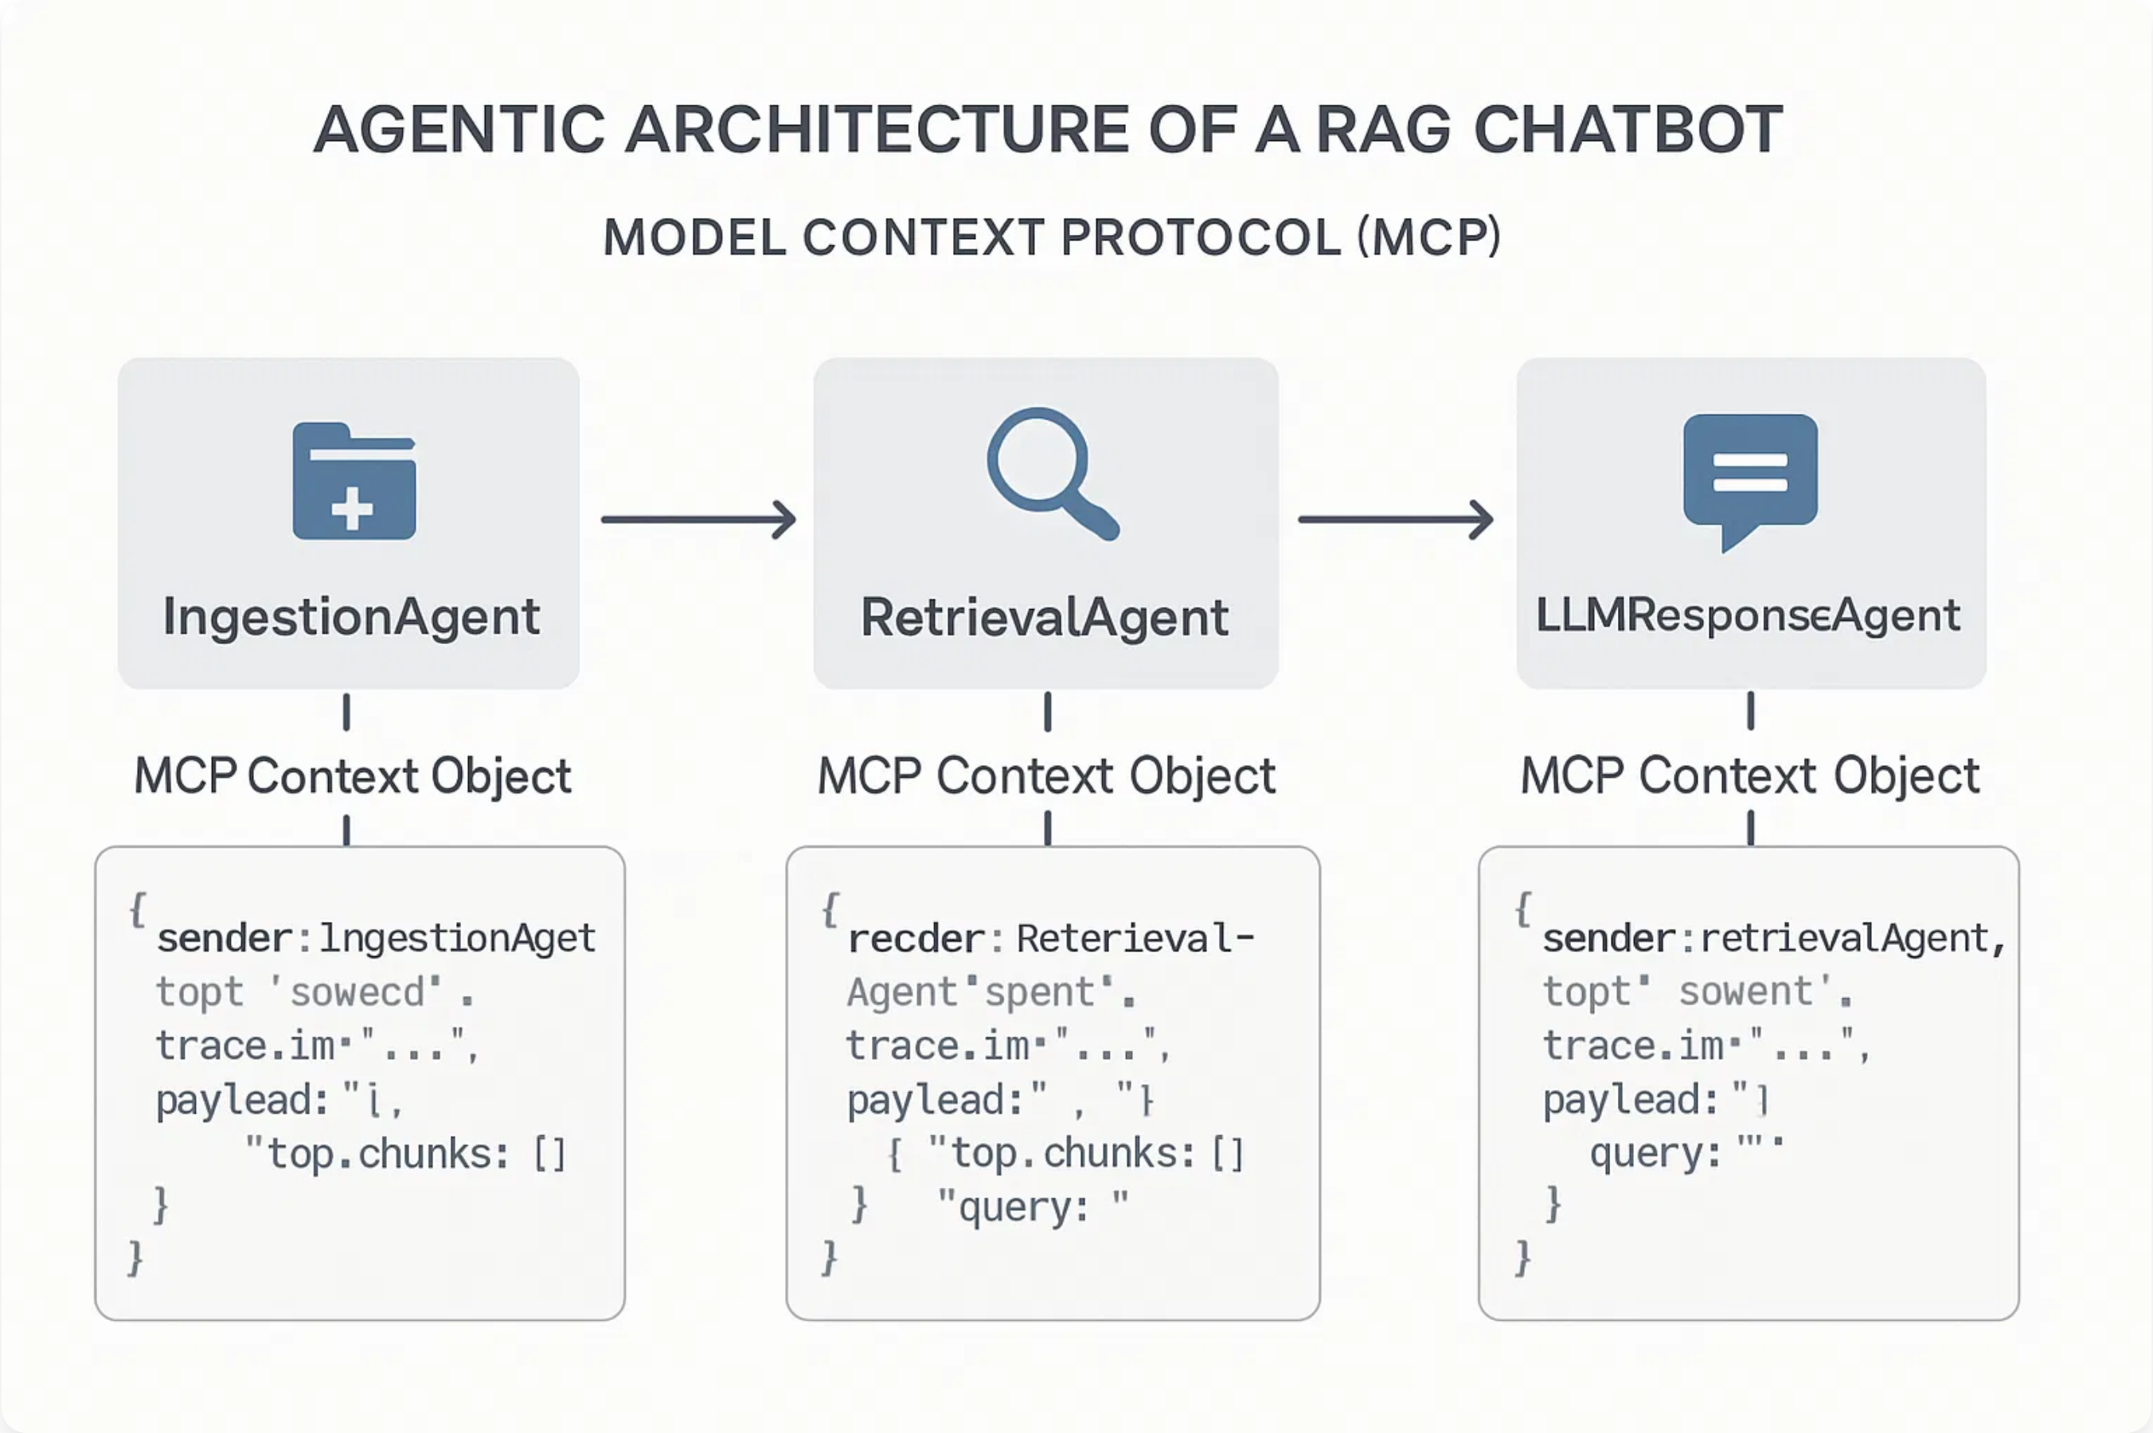
Agentic Architecture
The architecture follows an
agentic approach
with three specialized agents communicating via
Model Context
Protocol (MCP)
. Each agent performs a specific function in the document QA pipeline:
IngestionAgent
: Handles document parsing and preprocessing
RetrievalAgent
: Manages embeddings and semantic search
LLMResponseAgent
: Generates final answers using retrieved context
Agentic RAG Chatbot
4

Slide 5

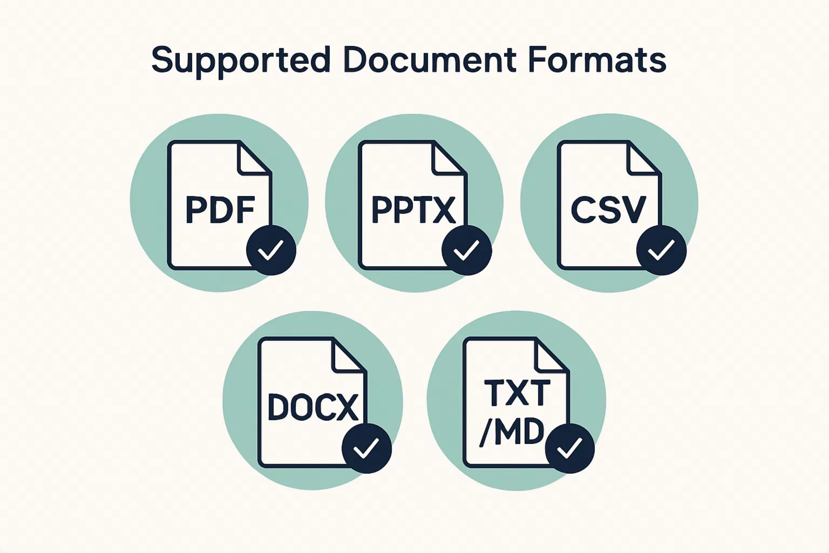
Supported Document Formats
Our RAG chatbot system processes multiple document formats, enabling seamless question answering across diverse content sources. Each format is parsed appropriately to extract meaningful text for embedding and retrieval.
Agentic RAG Chatbot
4

Slide 6



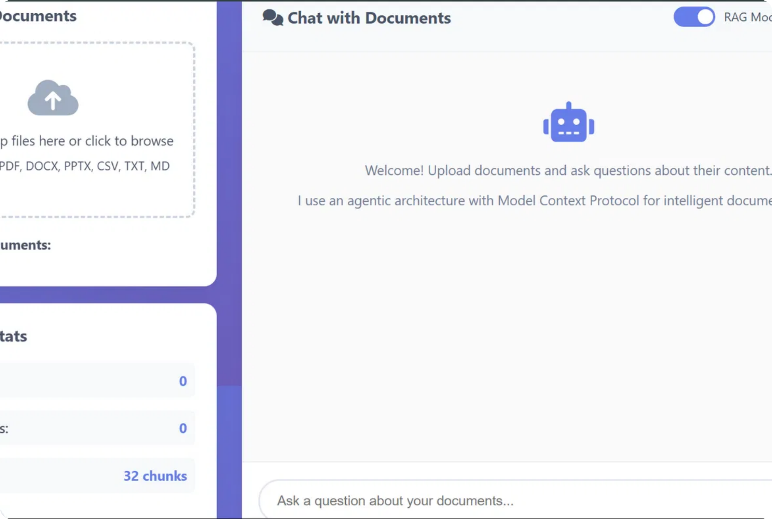
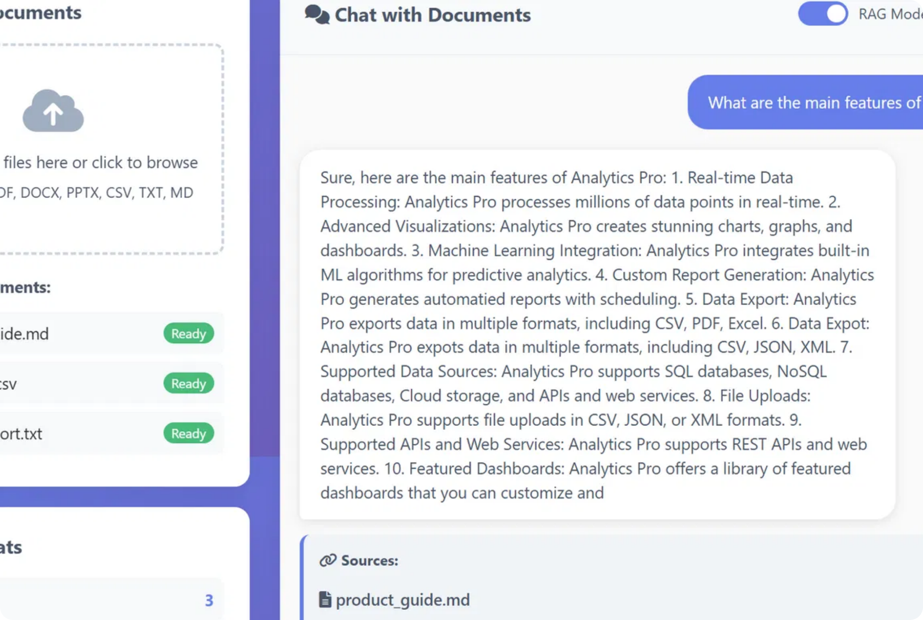
UI Screenshots
Document Upload Interface
Chat Interface
The upload interface supports drag & drop functionality for multiple document formats (PDF, DOCX, PPTX, CSV, TXT, MD) with real-time system statistics display.
The chat interface provides document-based question answering with source attribution, RAG mode toggle, and clear conversation history functionality.
Agentic RAG Chatbot
6

Slide 7











Implementation Approach
Technology Stack
Implementation Workflow
Python
LangChain
FAISS
Set up project structure with agent modules and MCP protocol
PyPDF2
python-pptx
pandas
Implement document parsers for each supported format
python-docx
markdown
FastAPI
Create vector store with FAISS for efficient retrieval
Develop agent communication using MCP context objects
Build FastAPI endpoints for document upload and chat
Implement frontend interface with document upload and chat UI
Agentic RAG Chatbot
7

Slide 8





Challenges Faced
Multi-Format Document Parsing
Agent Communication Protocol
Handling diverse document formats (PDF, PPTX, CSV, DOCX, TXT/MD) required different parsing strategies and libraries, with varying text extraction quality.
Implementing Model Context Protocol (MCP) required careful design to ensure proper message passing and state management between agents.
Solution: Created specialized parsers for each format with consistent output structure.
Solution: Developed standardized JSON schema with validation for all inter-agent communications.
Semantic Retrieval Accuracy
System Performance
Achieving high-quality semantic search results across different document types and content structures proved challenging.
Processing large documents and maintaining low latency for user interactions required performance optimization.
Solution: Implemented chunking strategies optimized for each document type and fine-tuned embedding models.
Solution: Implemented asynchronous processing, caching mechanisms, and optimized vector store queries.
Agentic RAG Chatbot
8

Slide 9





Future Scope & Improvements
Expand Agent Capabilities
Advanced LLM Integration
Enhanced User Interface
Introduce new agents for summarization, sentiment analysis, and data visualization to provide more comprehensive insights.
Explore more powerful language models and fine-tuning techniques for domain-specific knowledge and improved accuracy.
Add features like conversation history, user feedback mechanisms, and more interactive visualizations for a better user experience.
Scalability & Deployment
Improve system scalability for larger document volumes and user loads, and explore cloud deployment options for wider accessibility.
Agentic RAG Chatbot
9

Slide 10






Conclusion & Future Scope
The Agentic RAG Chatbot with Model Context Protocol provides a robust solution for multi-format document question answering. By leveraging specialized agents and structured communication, we achieve enhanced performance, maintainability, and user experience.
Expand agent capabilities
Performance optimization
User testing & feedback
Multi-language support
Image & table understanding
Presented by: Bhanu Prakash Guddeti

